Slide 1
Class Imbalance & RUSBoost
BUAD 5082
Team 5
Mengting Ding, Dylan Koury, Olivia Siegal

Slide 2

Agenda
Review of Classification
Class imbalance Problem
RUSBoost
Practice
Kahoot
Notes:
https://en.wikipedia.org/wiki/Boosting_(machine_learning)#:~:text=In%20machine%20learning%2C%20boosting%20is,weak%20learners%20to%20strong%20ones.
Review of what classification is
Confusion matrix
Class imbalance problem
Data set with 99 1's an 1 0's
Zillow – only one condo, rest were house...so how to trick the algorithm to be more in-tune with the minority class
Try basic logistic regression
Balance the imbalance dataset – under sample the big class (randomly delete majority class and oversample the minority class – clone the minority class)
Dr Chung will talk about boosting next week.
Family = binomial.

Slide 3












Classification
Predicting a qualitative response for an observation
Fish
Classifier Model
Mammal

Slide 4
Classification
Predicting a qualitative response for an observation
Fish
Classifier Model
Mammal

Slide 5
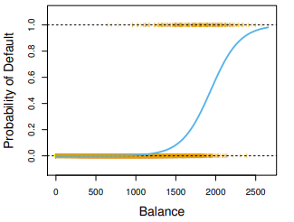
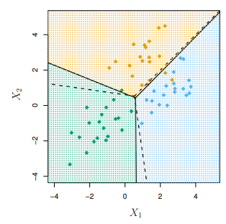
Classification Predictive Modeling
Binary Classification Problem
All observations belong in one of two classes
logistic regression, GAM (family = binomial)
Multiclass Classification Problem
All observations belong to one of three (or more) classes
LDA, QDA, KNN

Slide 6
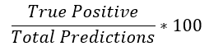
Classification errors
 |  | Actual
 |  | Positive | Negative
Predicted | Positive | True Positive | False Positive
 | Negative | False Negative | True Negative
Confusion Matrix
Summary of prediction results in reference to actual observations
Accuracy

Slide 7
Classification errors
 |  | Actual
 |  | + | -
Predicted | + | 10 | 1
 | - | 0 | 9
Confusion Matrix
Summary of prediction results in reference to actual observations
Accuracy

Slide 8
Classification errors
 |  | Actual
 |  | + | -
Predicted | + | 19 | 1
 | - | 0 | 0
Confusion Matrix
Summary of prediction results in reference to actual observations
Accuracy
Notes:
What do you guys think would cause something like that?

Slide 9
Class Imbalance
The distributions of observations across classes is not equal
Fish
Classifier Model
Mammal

Slide 10
Class Imbalance
Examples
Rare event, extreme event, severe class
Other examples?
Described with ratios
An imbalance of 1 to 100 means that for every one observation in one class there are 100 observations in the other class

Slide 11
Causes of Class Imbalance
Biased Sampling
Imbalance was caused by the way observations were collected from the sample domain
narrow geographical region
m
Property of the Sampling Domain
Some observations naturally occur in the sampling domain more than others
dominant genes
m
Measurement Errors
Human errors were made during data collection

Slide 12







How to Solve the Class Imbalance Problem
Balance the imbalanced dataset
Over-sample the minority class
Under-sample the majority class
m
Methods
Manually
Algorithms
RUSBoost
Boosting*
Class Imbalance
Over-sampling
Under-sampling

Slide 13
RUSBoost
RUS represents random under-sampling
Under-sampling is a data sampling method used to balance uneven dataset by reducing the size of majority classes.
Boosting
an ensemble method
In boosting, each tree is highly dependent on the trees that have already been grown.
RUSBoost is based on AdaBoost
Notes:
Boosting is one of ensembled learning method (random forest, bagging), it combines a set of weak learners and trains them sequentially to form a strong learner.
RUSBoost combines data under sampling and boosting to deal with imbalanced dataset.
https://imbalanced-learn.org/stable/references/generated/imblearn.ensemble.RUSBoostClassifier.html
https://rdrr.io/cran/ebmc/man/rus.html
Ensemble method: is a technique that combines multiple models together in order to improve the modelling result.
Boosting fits the residuals

Slide 14
RUSBoost in R
rus(formula, data, size, alg, ir = 1, rf.ntree = 50, svm.ker = "radial")
Formula
Data: data used for training model
Size: indicating number of weak learners in the ensemble model
Alg: learning algorithm
ir: imbalanced ratio (majority/minority)
rf.tree: number of decision trees in each forest when using rf in alg
Target value needs to be 0 or 1 (1 indicates minority, 0 indicates majority)
Notes:
class balancing is alleviated by random under-sampling the sample at each iteration of the boosting algorithm.
Only binary classification is implemented in rus()

Slide 15
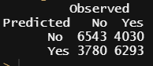
Recall: COVID Patients & Intubation (Case Study 4)
Predict if a COVID patient should or should not be intubated
m
Logistic Regression
Manually Balanced
m
RUSBoost
 |  | Actual
 |  | Not Intubated + | Intubated -
Predicted | Not Intubated + | 46,411 | 10,322
 | Intubated - | 10 | 1

Slide 16
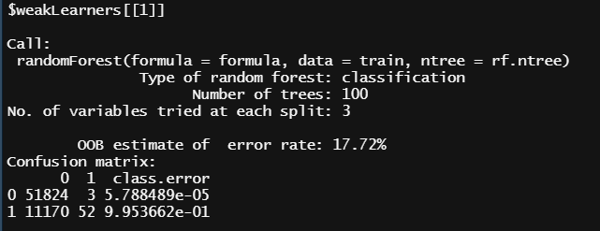
R Exercise – RUSBoost Output

Slide 17


